Slide 1
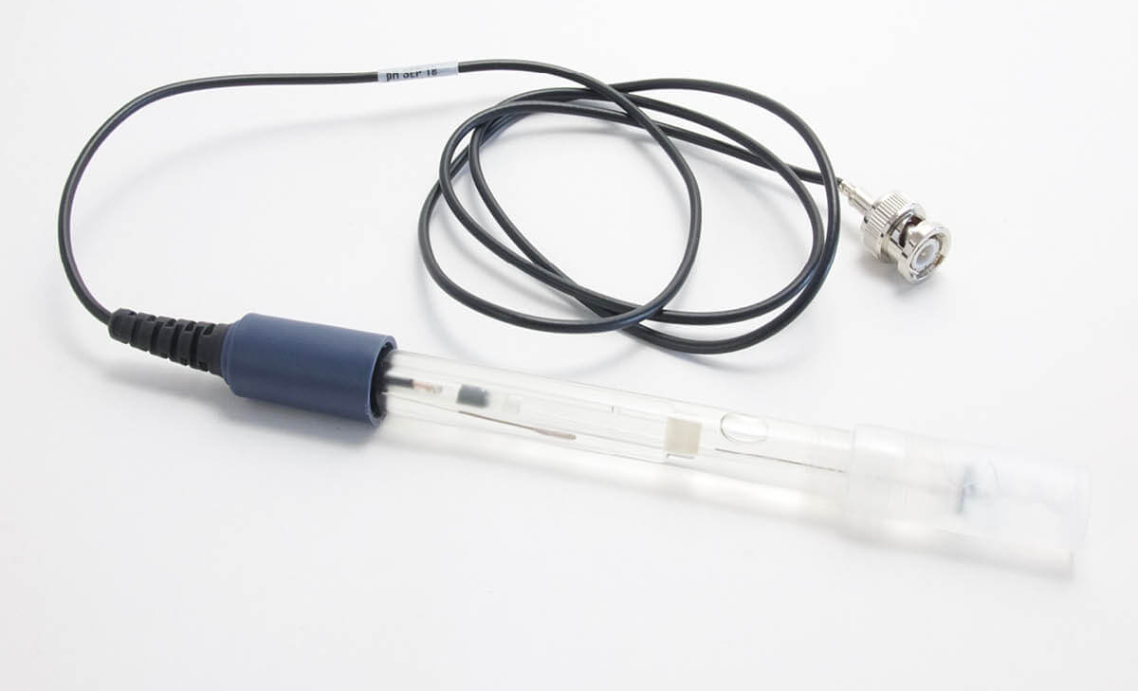
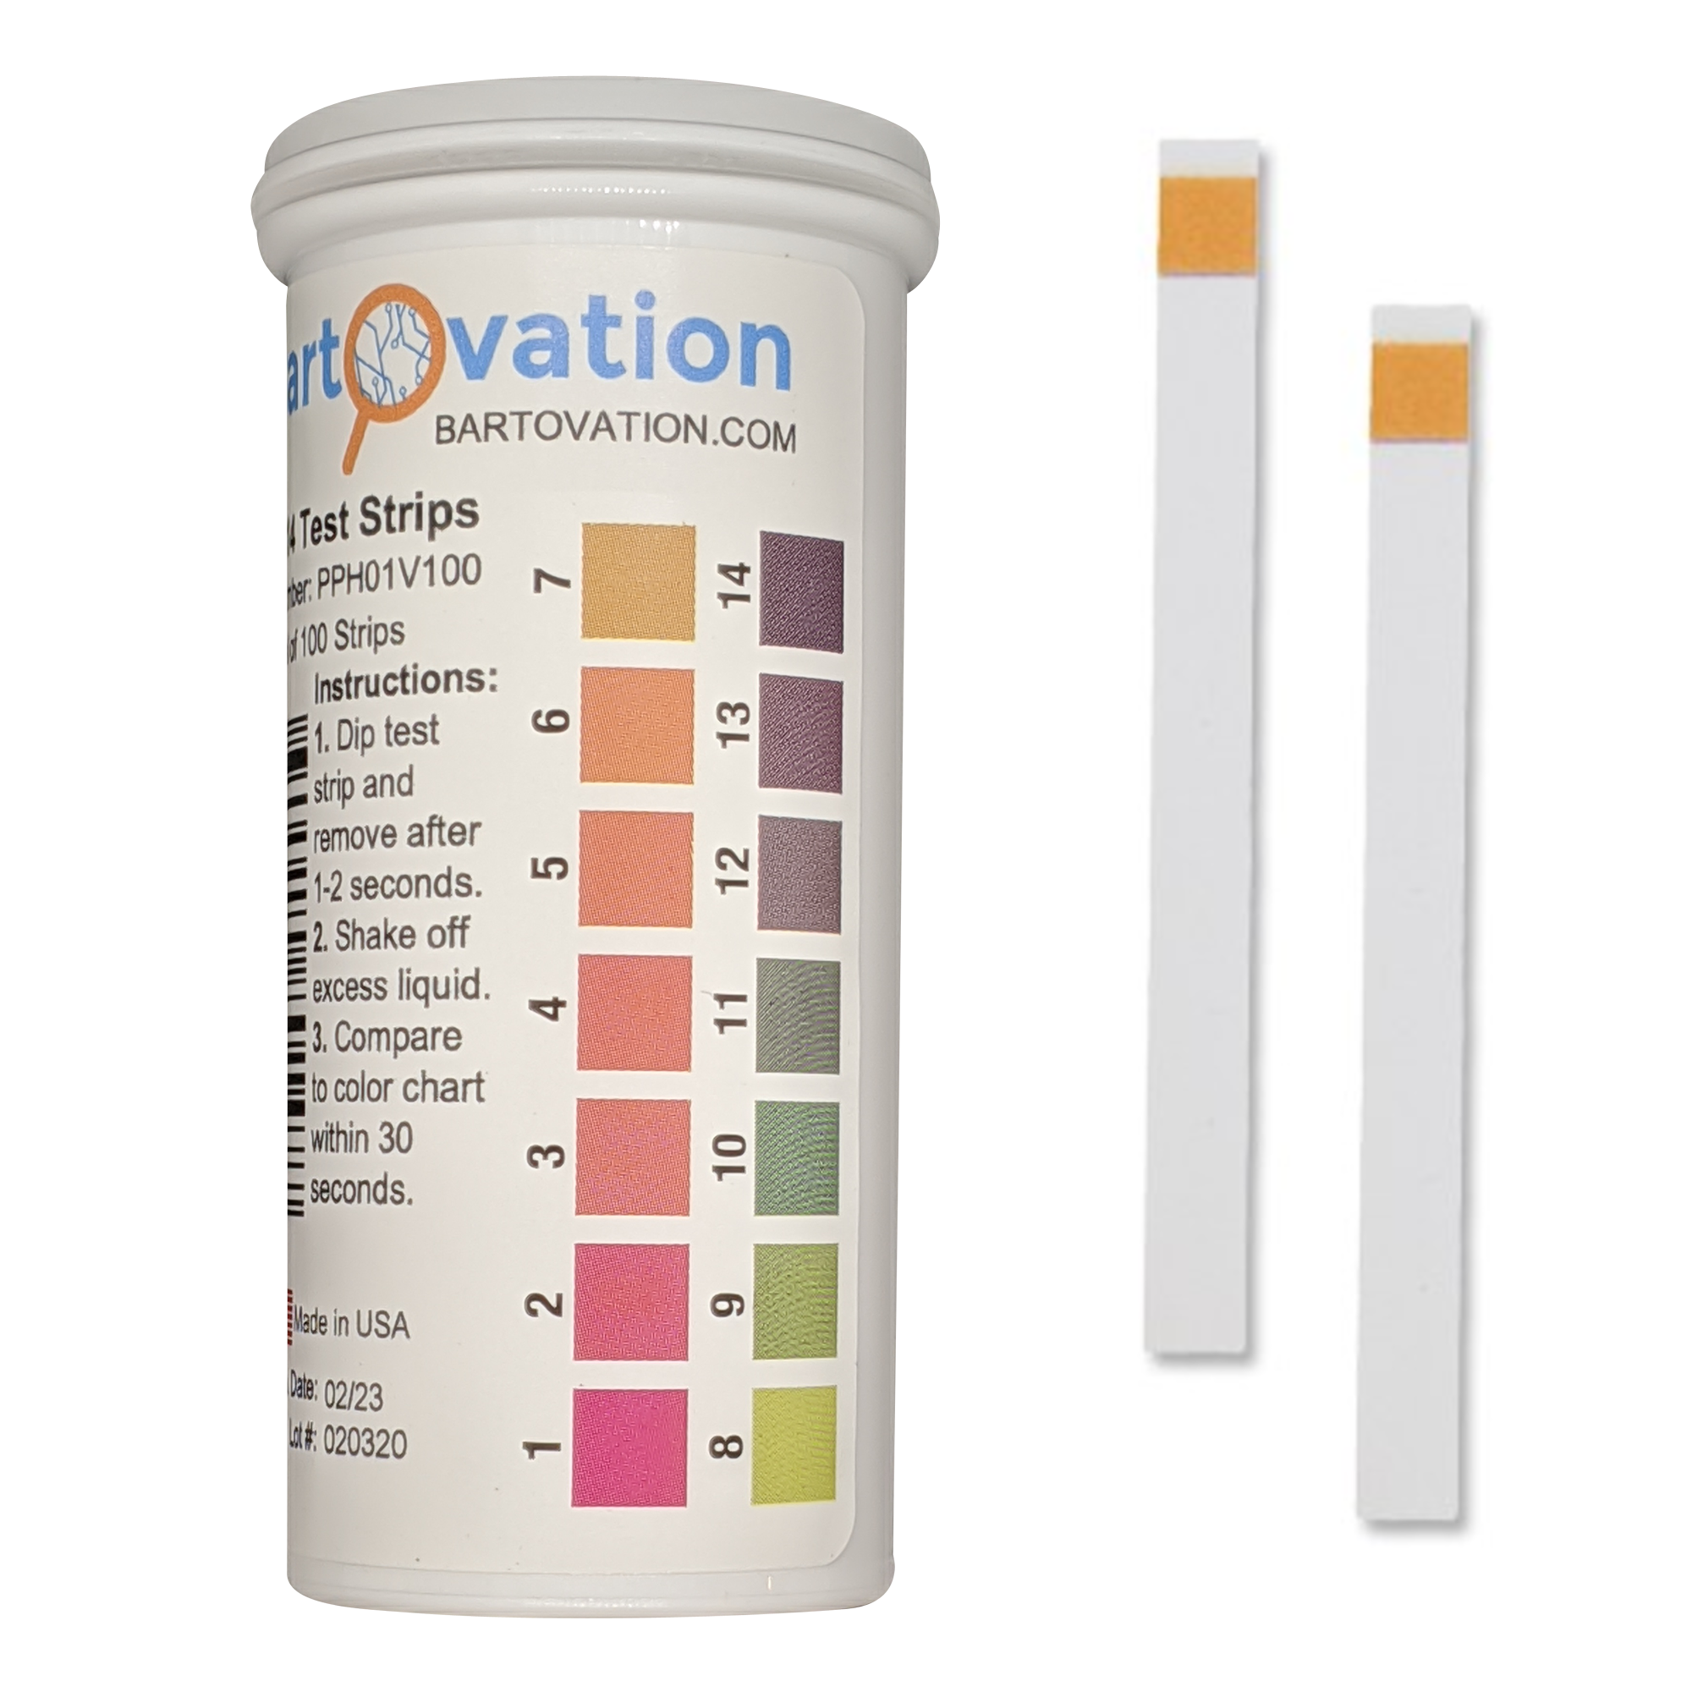
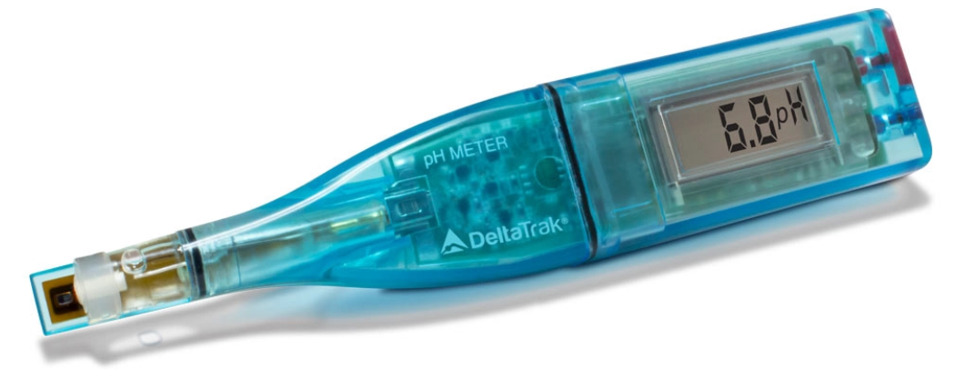
H_ISFET for pH sensing
Glass-electrode pH probe
ISFET pH sensor
Paper strips

Slide 2
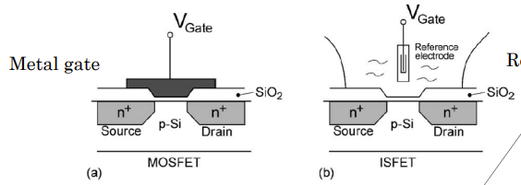
H_ISFET: Ion sensitive field effect transistor
Learning through questions:
What is the operating principle of FET-based biosensors and how are they typically fabricated?
What are the advantages and disadvantages of using an ISFET chip pH sensor instead of glass electrodes?
What are the applications of ISFET biosensors?
......
(Check all TP H preparation questions on Moodle before lab practice!)
MOSFET: metal-oxide-semiconductor field-effect transistor

Slide 3
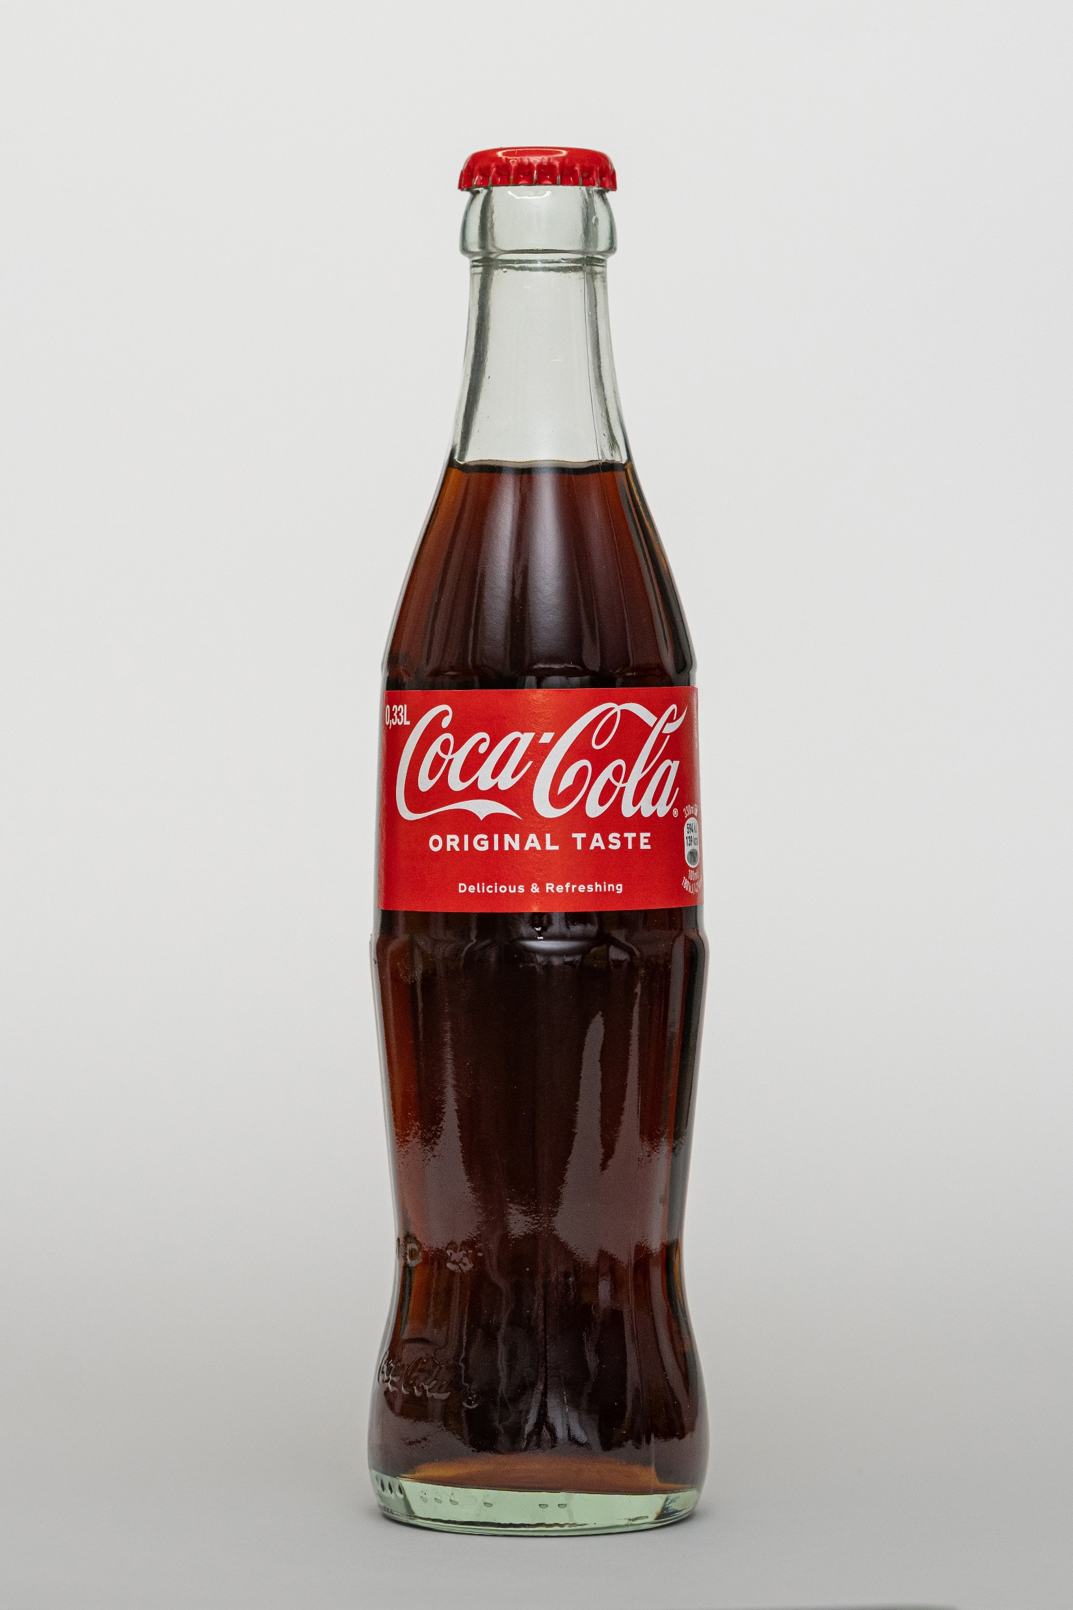

H_ISFET: Ion sensitive field effect transistor
Learning through experiments: measuring the pH of various solutions
Key elements: reference electrodes - an ISFET - buffer solutions with pH standards (pH of about 4, 7 and 9)
Part1: Re-make an Ag/AgCl electrode
Part2: pH sensing with a commercial ISFET

Slide 4

H_ISFET: Ion sensitive field effect transistor
Preparation, practice, and report writing
Part1
Before, answering TP H preparation questions with references is needed
During, taking notes/photos and interactive learning are encouraged
After, writing the obtained results immediately in your report is recommended
Part2
Before, getting familiar with formulas and experimental plans is needed
During, rigorous notetaking and practice are expected
After, writing results and submiting your report up to 2 weeks after Part2
Evaluation of your report: following the Writing_LAB_REPORTS_v.1.4b.doc for the format. Paragraphs written by AI won’t be evaluated; but you are encouraged to use it for searching and language polishing

